Slide 1
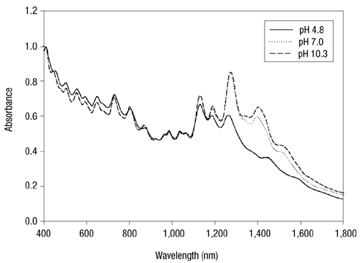
Last Update: 22 March 2023
Absorption spectra of HiPco CNT
Peak Wavelength(nm) | Diameter (nm)
1036 | 0.829
1128 | 0.904
1188 | 0.953
1272 | 1.02
1324 | 1.06
1128
1272
1036
1188
1324
v1->c1
metal
v2->c2 v1->c1
semiconduting
DNA-assisted dispersion and separation of carbon nanotubes, Ming Zheng
The spectra reveals the presence of 5 different peak wavelength with a diameter distribution spanning from 0.829 to 1.06 nm.
Wavelength (nm) | Diameter (nm)
1000 | 0.80
1200 | 0.96
1400 | 1.13
1600 | 1.29
My Data
Purification and Characterization of Single-Wall Carbon Nanotubes (SWNTs) Obtained from the Gas-Phase Decomposition of CO (HiPco Process), R. H. Hauge

Slide 2
Absorption spectra of HiPco CNT after DNA wrapping

Slide 3
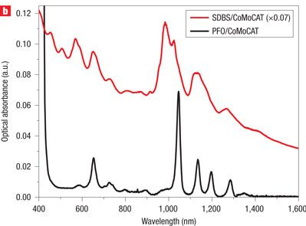
Absorption spectra of CoMoCAT CNT
Peak Wavelength (nm) | Diameter (nm)
984 | 0.787
1037 | 0.830
1137 | 0.912
1272 | 1.02
1137
1037
984
1272
Highly selective dispersion of single-walled carbon nanotubes using aromatic polymers, Robin J. Nicholas
The spectra reveals the presence of 4 different peak wavelength with a diameter distribution spanning from 0.787 to 1.02 nm.
Wavelength (nm) | Diameter (nm)
1000 | 0.80
1200 | 0.96
1400 | 1.13
1600 | 1.29
My Data
Purification and Characterization of Single-Wall Carbon Nanotubes (SWNTs) Obtained from the Gas-Phase Decomposition of CO (HiPco Process), R. H. Hauge

Slide 4
Absorption spectra of CoMoCAT CNT after DNA wrapping

Slide 5
Absorption spectra of HiPco & CoMoCAT CNT
My Data (test solution - DI water or 1x Tris solution)

Slide 6
PLE mapping of HipCo CNT
(10,2)
(10,2)
(9,4)
(8,7)
(9,4)
(8,6)
(8,7)
(8,6)
(9,5)
(8,3)
(9,5)
(8,3)
(7,5)
(7,6)
(7,5)
(7,6)
(10,3)
(10,3)
(8,4)
(8,4)
(6,5)
(6,5)
Excitation Wavelength (nm) | Emission Wavelength (nm) | Assignment
568 | 982 | (6,5)
668 | 961 | (8,3)
647 | 1032 | (7,5)
648 | 1131 | (7,6)
590 | 1122 | (8,4)
736 | 1065 | (10,2)
724 | 1114 | (9,4)
718 | 1183 | (8,6)
733 | 1274 | (8,7)
676 | 1253 | (9,5)
633 | 1258 | (10,3)
Excitation Wavelength (nm) | Emission Wavelength (nm) | Assignment
571 | 993 | (6,5)
671 | 971 | (8,3)
651 | 1044 | (7,5)
654 | 1139 | (7,6)
594 | 1131 | (8,4)
740 | 1077 | (10,2)
725 | 1127 | (9,4)
724 | 1197 | (8,6)
731 | 1284 | (8,7)
678 | 1265 | (9,5)
633 | 1268 | (10,3)
SC-SWCNT
RNA-SWCNT

Slide 7
PLE mapping of HipCo CNT
My Unwrapped sample
Jaehoon’s Unwrapped sample
My RNA Wrapped sample
Jaehoon’s DNA Wrapped sample

Slide 8
PLE mapping of CoMoCAT CNT
(9,4)
(9,4)
(7,6)
(7,5)
(7,6)
(7,5)
(8,4)
(8,4)
(6,5)
(6,5)
SC-SWCNT
Excitation Wavelength (nm) | Emission Wavelength (nm) | Assignment
570 | 983 | (6,5)
646 | 1031 | (7,5)
591 | 1123 | (8,4)
648 | 1130 | (7,6)
724 | 1113 | (9,4)
RNA-SWCNT
Excitation Wavelength (nm) | Emission Wavelength (nm) | Assignment
573 | 998 | (6,5)
652 | 1046 | (7,5)
594 | 1134 | (8,4)
654 | 1142 | (7,6)
728 | 1128 | (9,4)
My data (My data – Table1)

Slide 9
PLE mapping of CoMoCAT CNT
My Unwrapped sample
Jaehoon’s Unwrapped sample
My RNA Wrapped sample
Jaehoon’s DNA Wrapped sample

Slide 10
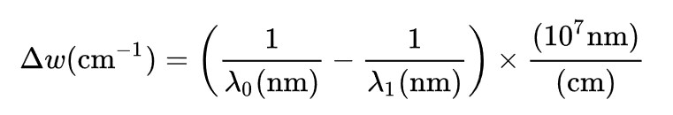
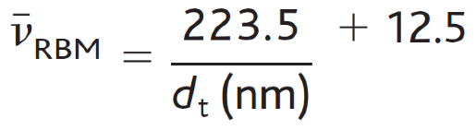
Raman Spectra of HipCo CNT 785nm
Wave number to wavelength
dt calculated using this formula:
Raman intensity peak correspond CNT assignment from Table 1
My Data
assignment | Predicted v_RBM (cm^-1) | v_RBM (cm^-1) | dt (nm)
(9,7) | 214.9 | 214.7 | 1.104249
(10,3) | 225.1 | 225.2 | 1.05127
(11,3) | 232.8 | 232.4 | 1.014526
(10,2) | 265.1 | 264.1 | 0.884798
(7,6) | 262.1 | 264.1 | 0.895433
(11,3)
(10,3)
The Raman spectra reveals the presence of 5 different semiconducting (n,m) with a diameter (dt) distribution spanning from 0.885 to 1.10 nm.
(9,7)
(10,2)
(7,6)

Slide 11
Raman Spectra of CoMoCAT CNT 785nm
assignment | Predicted v_RBM (cm^-1) | v_RBM (cm^-1) | dt (nm)
(9,7) | 214.9 | 216.5 | 1.104249
(12,2) | 227 | 226.8 | 1.041958
(11,3) | 232.8 | 232.6 | 1.014526
(11,1) | 256.4 | 257 | 0.916359
(10,2) | 265.1 | 265.1 | 0.884798
My Data
The Raman spectra reveals the presence of 5 different semiconducting (n,m) with a diameter (dt) distribution spanning from 0.885 to 1.10 nm.
(12,2)
(11,3)
(9,7)
(10,2)
(11,1)

Slide 12
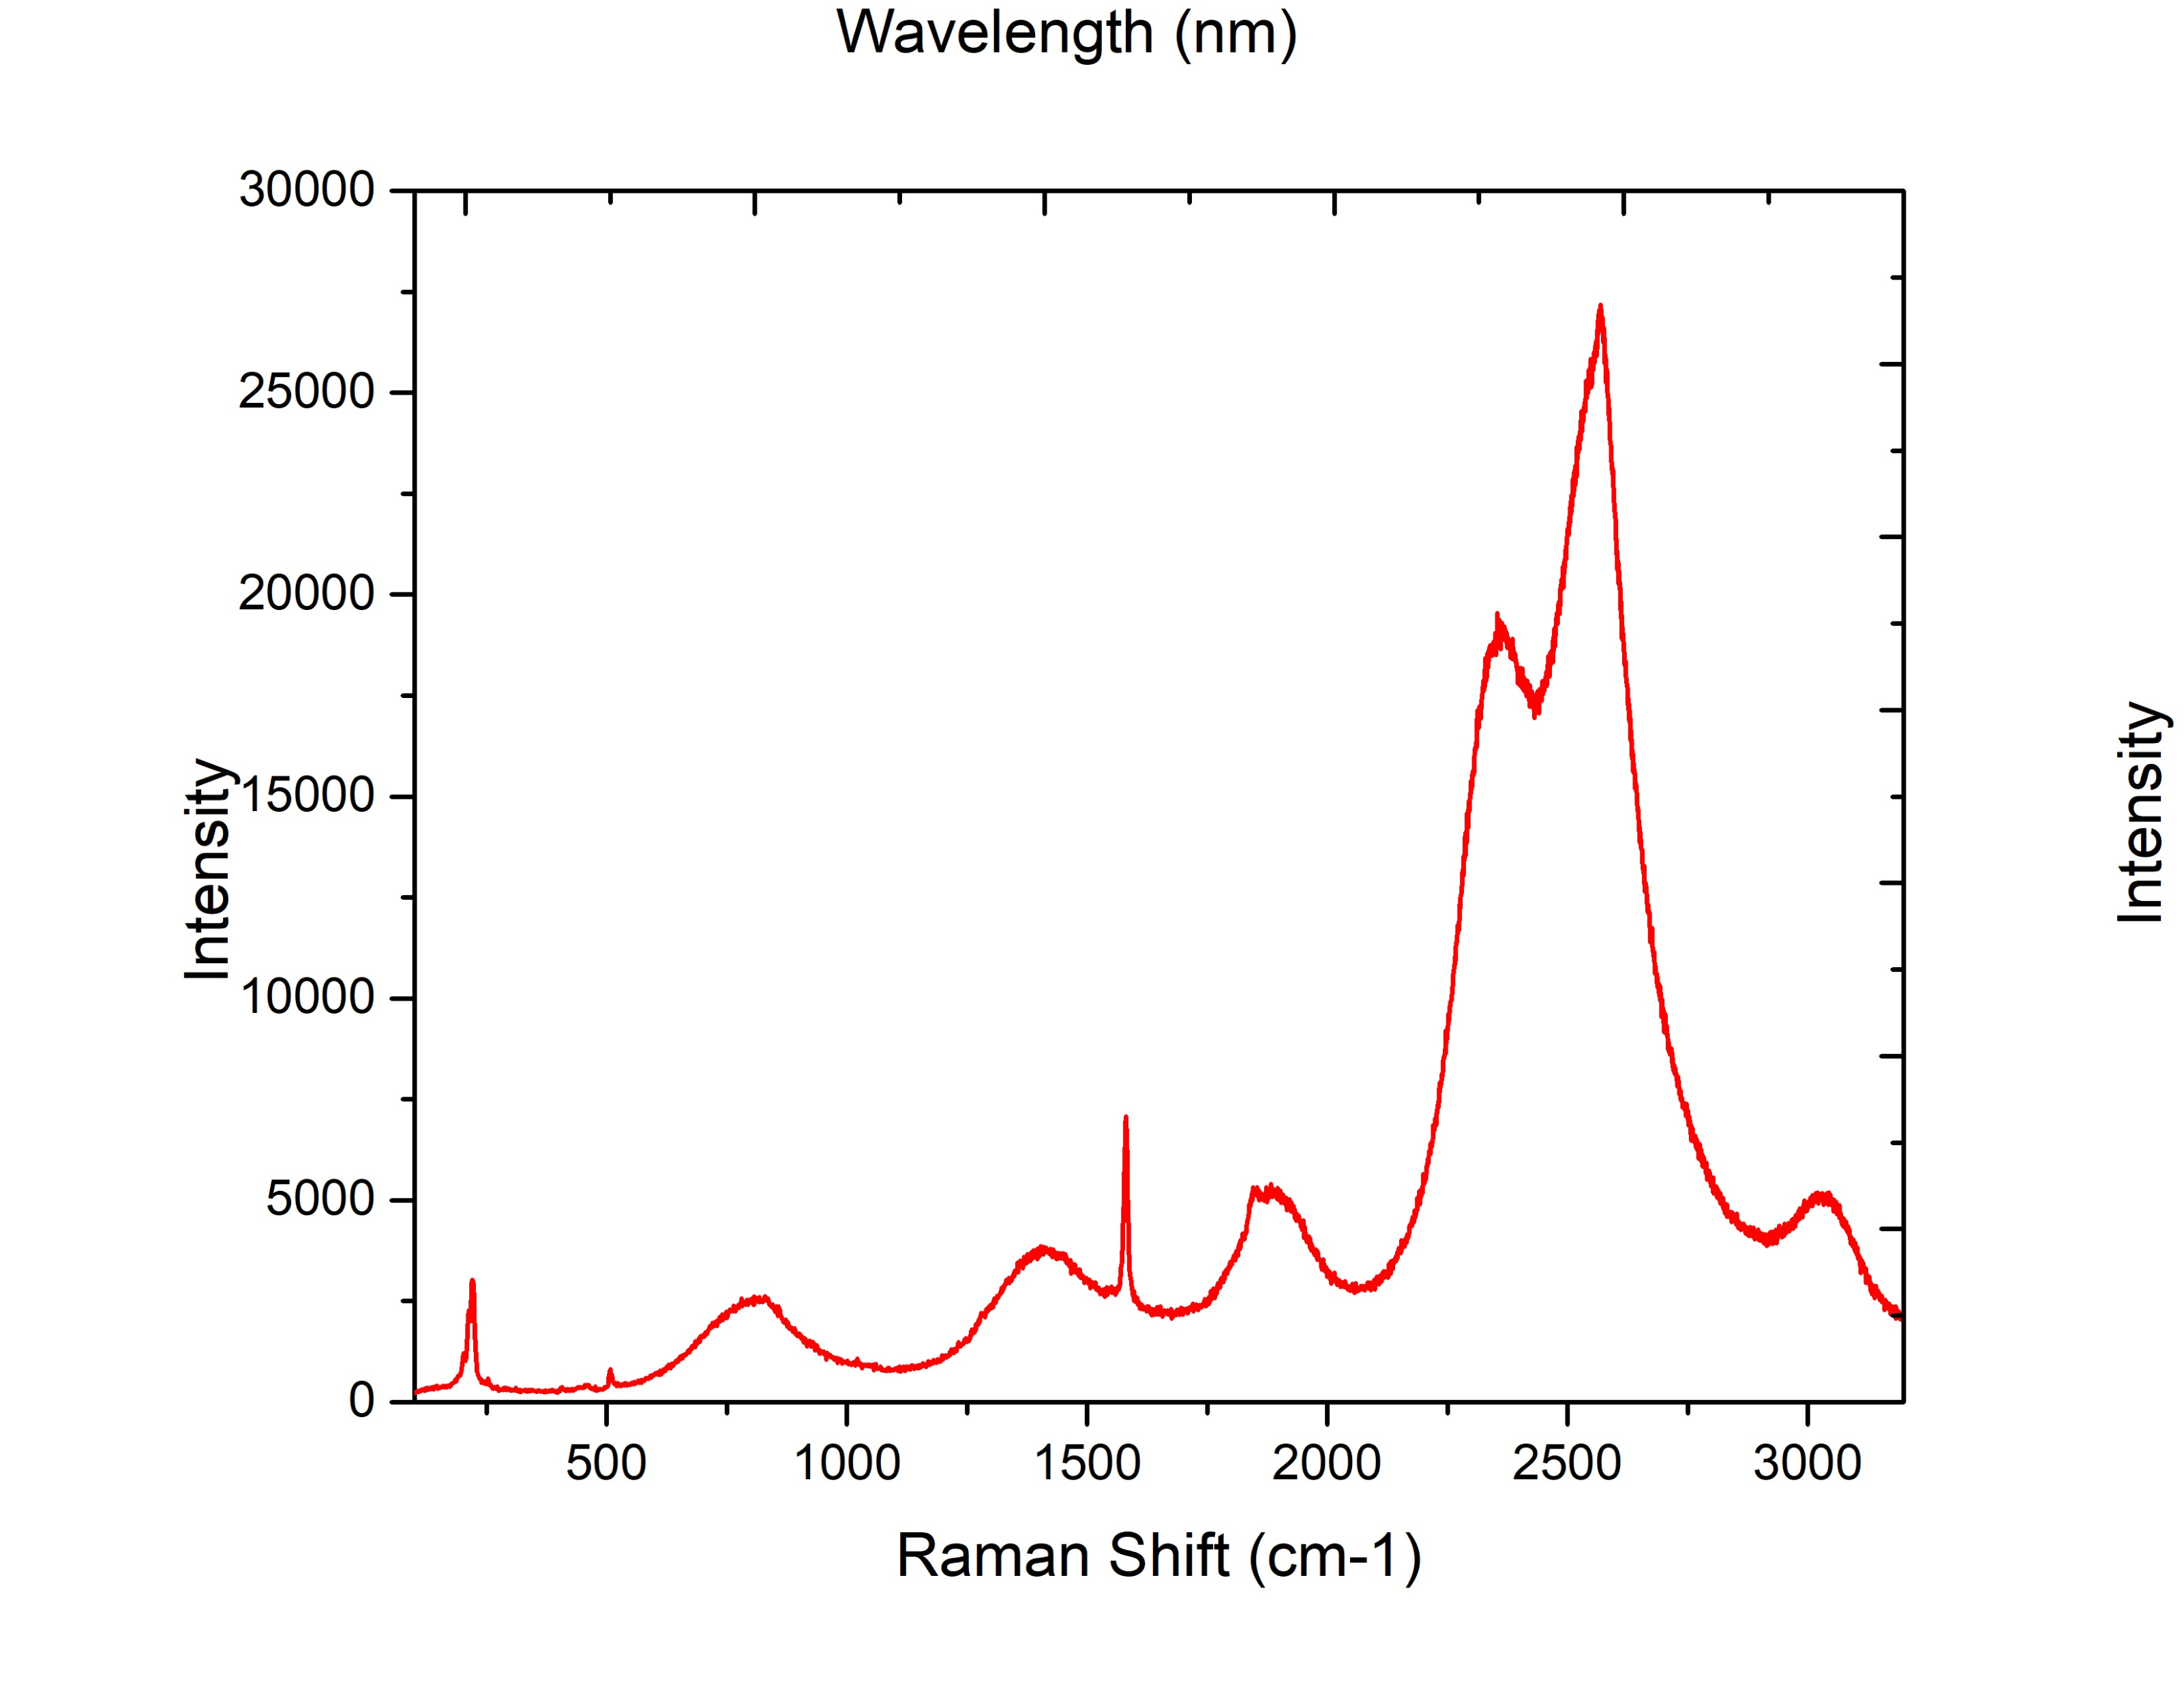
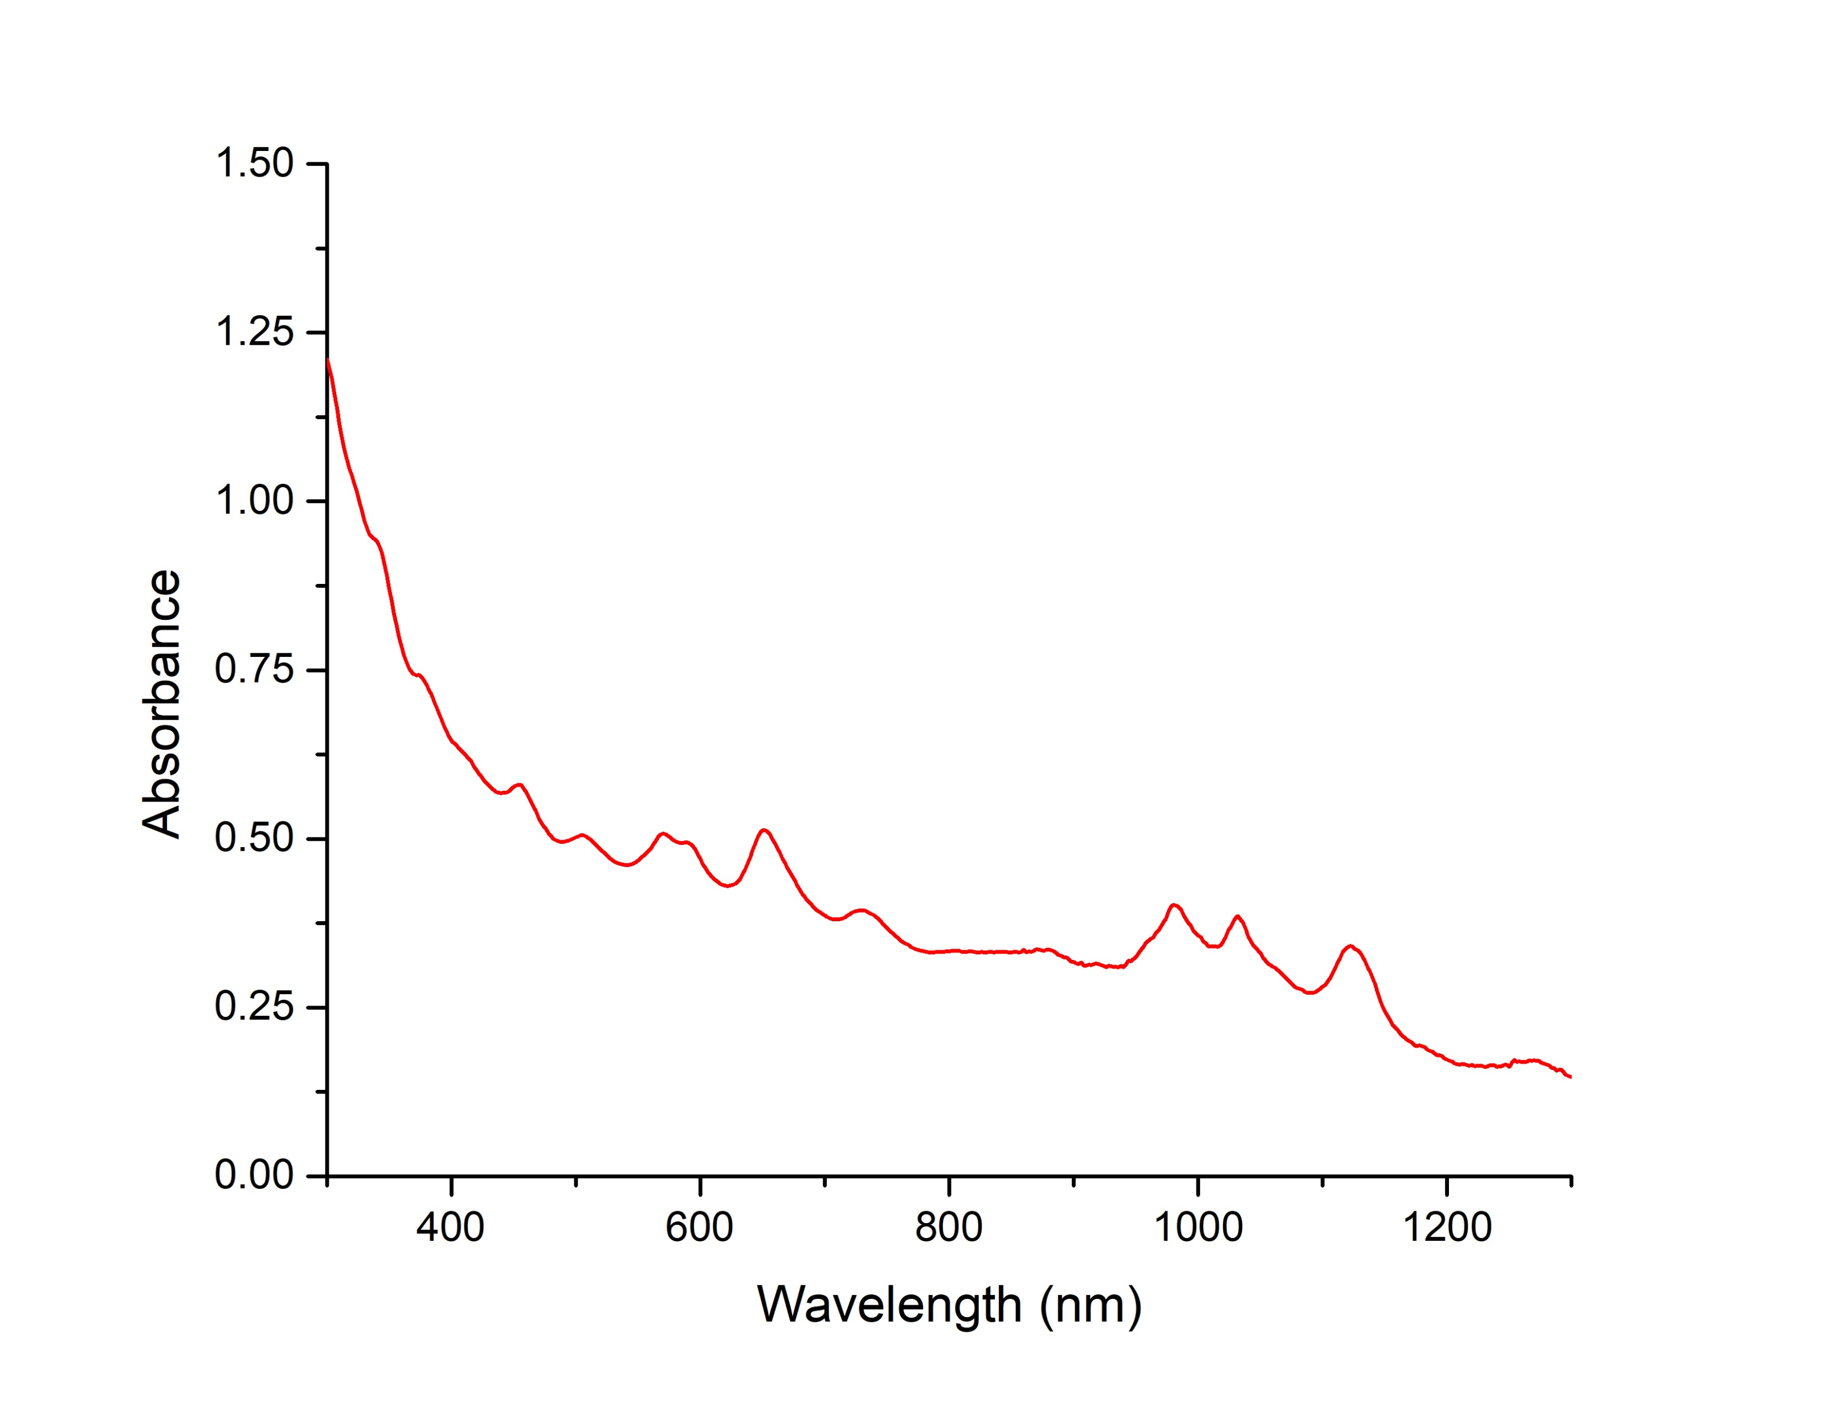
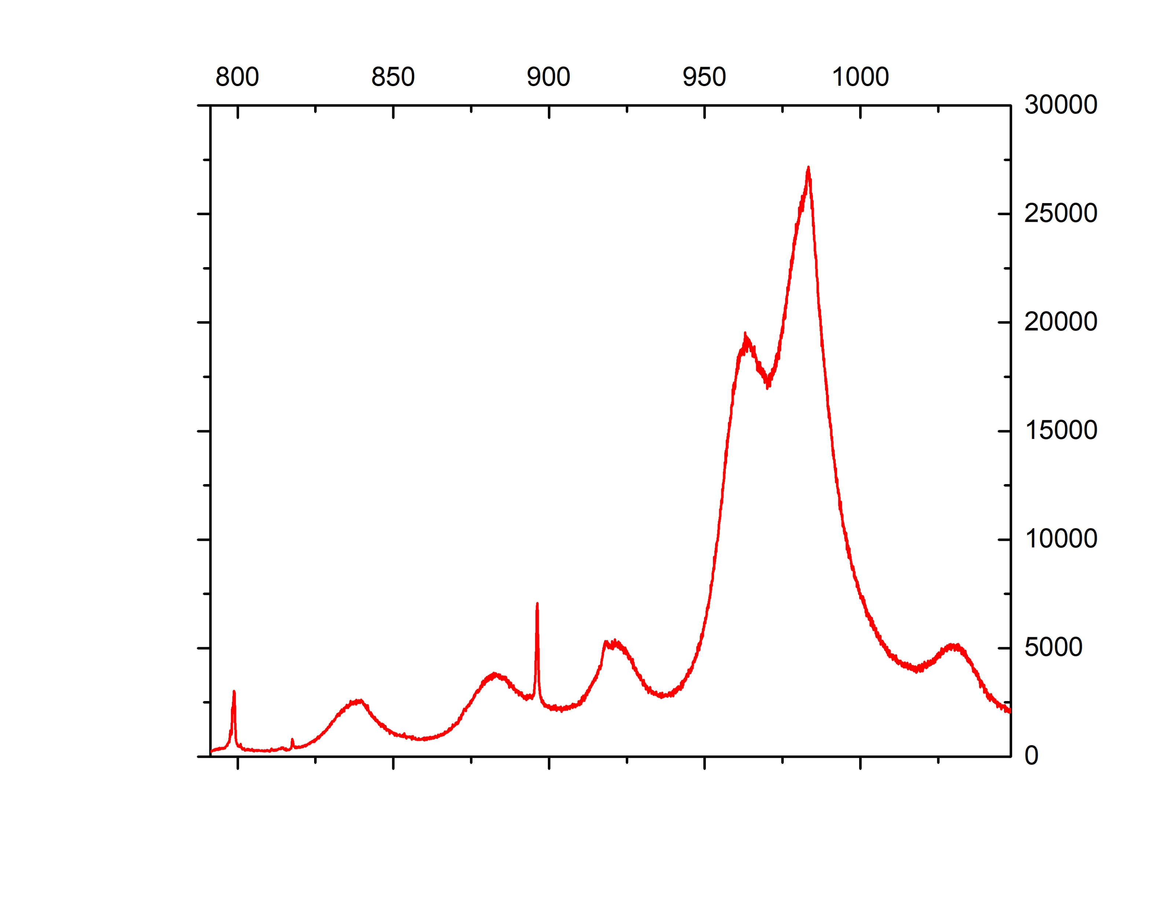
Harshith’s SC CNT - CoMoCAT
G’ peak
(8,3)
G peak
RBM
(9,1)
(6,4)
SC CNT Synthesis Procedure:
Disperse 15 mg SWNT and 0.6 g Sodium Cholate (SC) in 30 mL H2O.
Probe-tip sonicate for 1 hour at 70% amplitude (Total power on tip sonicator = 130 W).
Transfer the surfactant into centrifuges according to same weight.
Ultracentrifuge for 2 hours at 30,000 RPM.

Slide 13
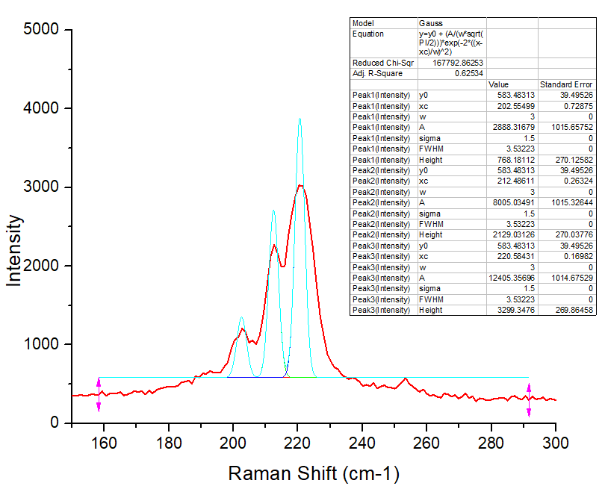
SC CNT Characterisation in RBM Zone
Wavelength(nm) to Wave number (cm⁻¹)
dt calculated using this formula:
(11,4)
(13,2)
RBM Peaks (cm⁻¹) | Relatable Kataura Plot values | dt (nm) | Species assignment (n,m)
202.555 | 203.6 | 1.17 | (9,8)
212.486 | 212.1 | 1.12 | (13,2)
220.584 | 221.7 | 1.068 | (11,4)
(9,8)

Slide 14
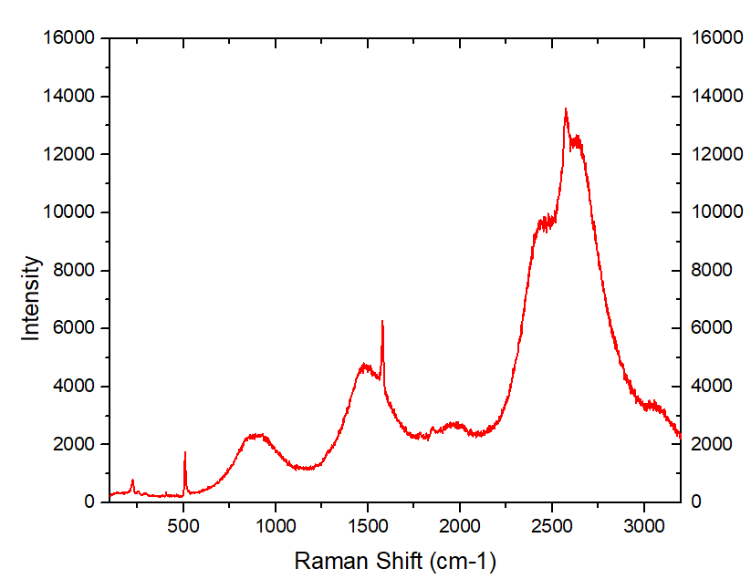
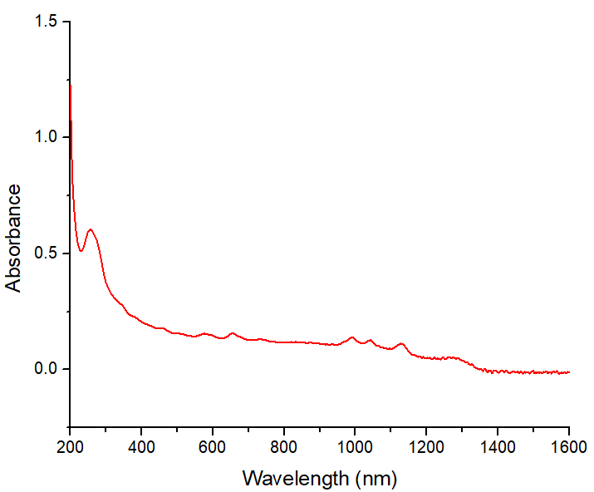
DNA wrapped CNT (Dialysis from SC-CNT)
G’ peak
(6,5)
DNA
(8,3)
CNT Species
G peak
Silicon
Water
(6,4)
RBM
(9,1)

Slide 15
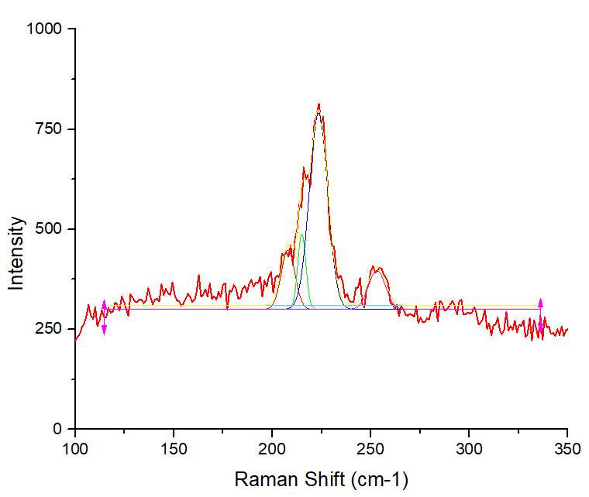
DNA wrapped CNT (Dialysis) – RBM Zone
Wavelength(nm) to Wave number (cm⁻¹)
dt calculated using this formula:
RBM Peaks (cm⁻¹) | Relatable Kataura Plot values | dt (nm) | Species assignment (n,m)
208 | 207.7 | 1.145 | (12,4)
215 | 215.1 | 1.103 | (9,7)
223 | 221.7 | 1.068 | (11,4)
244 | 241.6 | 0.976 | (9,5)
253 | 251.3 | 0.936 | (10,3)
Notes:
208 215 223 244 253

Slide 16
SC CNT with 633 nm Laser
G peak
G’ peak
RBM

Slide 17
Absorbance of SC-CNT (3X)
Extinction coefficient for SC-CNT = 3.6 1e4 cm²/gm
At 632 nm Absorbance of sample is 0.48144
$$A= ε.C.L$$
$$0.48144=3.6×{10}^{4} \frac{{cm}^{2}}{gm}×C×1 cm$$
$$0.48144=3.6×{10}^{−2} \frac{L}{mg}×C$$
$$C=13.37$$
$$3C=40.12$$
Concentration of SC-CNT in sample is 40.12 mg/L
632

Slide 18
Parameter trials for PL mapping
Excitation Slit Width (nm) | Emission Slit Width (nm) | Integration Time (sec) | Intensity
4 | 4 | 0.4 | 6000
3 | 3 | 0.5 | 3500
5 | 2 | 0.4 | 4000
5 | 2 | 0.5 | 4000
5 | 1 | 0.3 | 2500
5 | 1 | 0.4 | 2500
5 | 3 | 0.4 | 6000
Best Choice
Final decided parameters:
Excitation: 500-700 nm, Increment: 2 nm, Slit Width: 5 nm
Emission: 900-1200 nm, Increment: 2 nm, Slit Width: 3 nm
Integration time: 0.4 sec

Slide 19
PL Mapping of SC-CNT
Jaehoon’s Data
CNT Species | Excitation (nm) | Emission (nm)
(6,5) | 570 | 985
(7,5) | 645 | 1035
(7,6) | 650 | 1130
(8,4) | 590 | 1125

